Slide 1

Module 1: Getting Familiar with RC

Slide 2


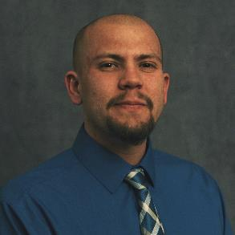



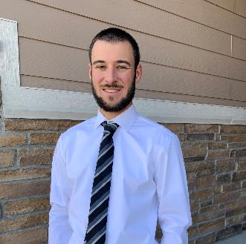


Meet the User Support Team
Layla Freeborn
Brandon Reyes
Andy Monaghan
Michael Schneider
John
Reiland
Dylan Gottlieb
Mohal Khandelwal
Ragan
Lee
2

Slide 3
Learning Goals
Understand CURC Resources & the Alpine cluster
Getting an account & logging in
Navigate the RC system

Slide 4


Ask Questions
Discuss Ideas
Notes:
This workshop is meant to be empowering and information-rich – to help you get the most out of your HPC workflow.
Feel free to ask questions during the presentations and to discuss ideas/thoughts during breaks and the hands-on portion of the workshop.

Slide 5
RC Resources
Tech Support
High Performance Computing
Data Management
Cloud Computing
Secure Research
Human Support
Training Materials & Workshops
Consultations & Office Hours
Help Tickets
Notes:
The Secure Research manages the CMMC environment (Preserve), but we can help users connect with the SR team if they have confidential data (e.g. HIPA, Financial, FERPA, Government data, etc.)

Slide 6

High Performance Computing (HPC)

Slide 7
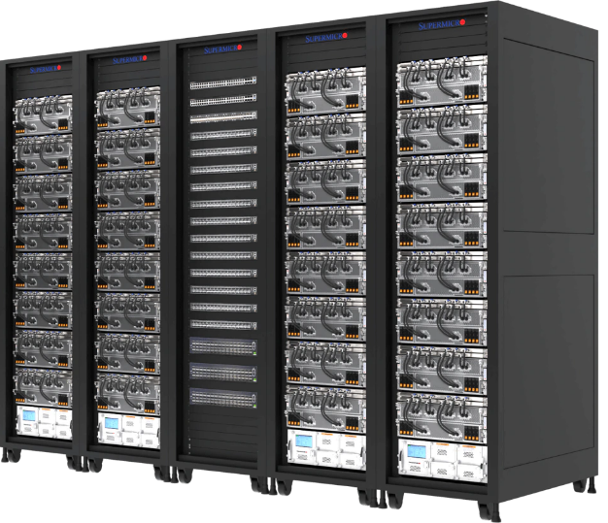
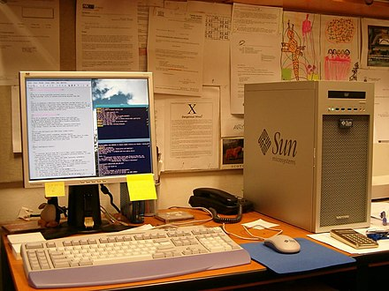
Traditional vs HPC
Fewer Computing Resources,
Fast Sprinter*
More Computing Resources,
Steady Marathon Runner*
*Potentially
Notes:
Traditional PC:
- 1 CPU with a few cores and maybe a GPU (not always)
- RAM & Storage measured in GB’s
- Less Hardware, but potentially much faster hardware (clockspeed)
HPC
Many CPU’s and GPUs – Thousands of cores
RAM & Storage measured in Terabytes and Petabytes
Hardware built for stability and high up-time, best for distributed jobs

Slide 8

What can I use HPC for?
Tiny Job
Big Job
Tiny Job
Tiny Job
Parallel Jobs
Serial Jobs
Notes:
Parallel Jobs - Divide and Conquer
A job that can be divided into smaller pieces, which can be independently run.
Serial Jobs
A collection of small jobs which can be done simultaneously

Slide 9



What can I use HPC for?
Big Data
Viz/Rendering
Shared Work Environment
Notes:
Big Data:
- Require lots of RAM (memory) or data storage
- Need more CPU’s, distributed system
Visualization Rendering
Unique Hardware
- GPU’s, Linux, Shared team environment

Slide 10
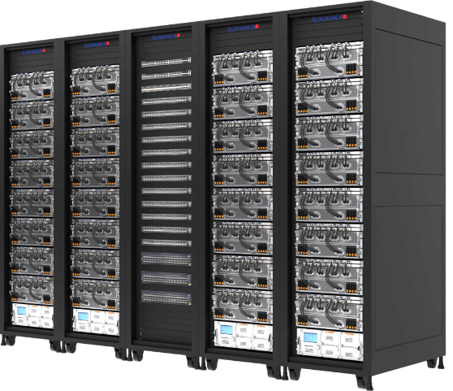
HPC Cluster: Alpine
3rd-generation HPC cluster
Janus (2012)
RMACC Summit (2017)
Heterogeneous cluster with hardware currently provided by CU Boulder, CSU, and Anschutz
Access available to CU Boulder, CSU, AMC and RMACC users
ALPINE
Notes:
Update Icon

Slide 11
Alpine Partitions
Partition | Description | # of nodes | RAM/core (GB) (qty.) | cores/node (qty.) | GPUs/node
amilan/amilan128c | General Compute Node: AMD Milan | 390 (amilan), 16 (128c) | 3.74 (390), 2.01 (16) | 128 (16), 64 (313), 48 (28), 32 (49) | 0
ami100 | GPU Node: 3x AMD MI100 | 8 | 3.74 | 64 | 3
aa100 | GPU Node: 3x Nvidia A100 | 12 | 3.74 | 64 | 3
amem | High-memory node | 24 | 21.5 (12), 16 (12) | 128 (2), 64 (10), 48 (12) | 0
al40 | GPU Node: 3x Nvidia L40 | 3 | 3.74 | 64 | 3

Slide 12

HPC Cluster: Alpine
Interconnect
CPU nodes: HDR-100 InfiniBand* (200Gb inter-node fabric)
GPU nodes: 2x25 Gb Ethernet +RoCE
Scratch Storage: 25Gb Ethernet +RoCE
Operating System
RHEL 8 - RedHat Enterprise Linux Version 8
ALPINE
* Not all CPU Nodes have Infiniband

Slide 13



Node Types
LOGIN
COMPILE
COMPUTE
Notes:
Add diagram showing login node as entry point.
Login -> Testing, Compiling, Compute/GPU

Slide 14


Node Types
LOGIN
COMPILE
COMPUTE
Entry to system
View or edit files
Submit jobs
Notes:
Add diagram showing login node as entry point.
Login -> Testing, Compiling, Compute/GPU

Slide 15

Node Types
LOGIN
COMPILE
COMPUTE
View or edit files
Submit jobs
Compile code
Install software
Notes:
Add diagram showing login node as entry point.
Login -> Testing, Compiling, Compute/GPU

Slide 16
Node Types
LOGIN
COMPILE
COMPUTE
Run scheduled jobs
Handle calculations
Notes:
Add diagram showing login node as entry point.
Login -> Testing, Compiling, Compute/GPU

Slide 17





Where do I run jobs?
LOGIN
COMPILE
COMPUTE
Notes:
Add diagram showing login node as entry point.
Login -> Testing, Compiling, Compute/GPU

Slide 18

Node Types
DATA (DTN)
Support data transfers
Can be selected when using scp, sftp, or ssh transfers

Slide 19
Storage at CURC
Core
PetaLibrary
Included with RC account
/home
/projects
/scratch
Paid Service for large data
Storage
Archival Backup
Sharing

Slide 20
Core Filesystem Structure
/home (2GB) | /projects (250GB) | /scratch/alpine (10TB)
Scripts and Code Important files (small)
Not for: File Sharing Large Files
Configuration Files, Notes

Slide 21
Core Filesystem Structure
/home (2GB) | /projects (250GB) | /scratch/alpine (10TB)
Scripts and Code Important files (small) | Code/files/libraries Software you are installing Sharing files
Not for: File Sharing Large Files | Not for Job Output Temporary Files
Configuration Files, Notes | Job Scripts, Shareable Files

Slide 22
Core Filesystem Structure
/home (2GB) | /projects (250GB) | /scratch/alpine (10TB)
Scripts and Code Important files (small) | Code/files/libraries Software you are installing Sharing files | Output from running jobs Large files/datasets Sharing files
Not for: File Sharing Large Files | Not for Job Output Temporary Files | Not for Long Term Storage
Configuration Files, Notes | Job Scripts, Shareable Files | Job Output Files, Data Files

Slide 23
PetaLibrary Tiers
Active | Archive | Active + Archive | Archive + DR
Performance Tier¹ Accessible by All Nodes No File Limit Double Parity lz4 compression
¹ Slower than /scratch, ² Per Terabyte

Slide 24
PetaLibrary Tiers
Active | Archive | Active + Archive | Archive + DR
Performance Tier¹ Accessible by All Nodes No File Limit Double Parity lz4 compression | Integrity Tier Accessible by Login Nodes Only 10,000 File Limit² Triple Parity zstd compression
¹ Slower than /scratch, ² Per Terabyte

Slide 25
PetaLibrary Tiers
Active | Archive | Active + Archive | Archive + DR
Performance Tier¹ Accessible by All Nodes No File Limit Double Parity lz4 compression | Integrity Tier Accessible by Login Nodes Only 10,000 File Limit² Triple Parity zstd compression | Replicate Active into Archive Updated every 15 minutes No File Limit
¹ Slower than /scratch, ² Per Terabyte

Slide 26
PetaLibrary Tiers
Active | Archive | Active + Archive | Archive + DR
Performance Tier¹ Accessible by All Nodes No File Limit Double Parity lz4 compression | Integrity Tier Accessible by Login Nodes Only 10,000 File Limit² Triple Parity zstd compression | Replicate Active into Archive Updated every 15 minutes No File Limit | Disaster Recovery Monthly backup to offsite location
¹ Slower than /scratch, ² Per Terabyte

Slide 27

Data Sharing: Within RC
/home ← Private!!!
/project
/scratch
PetaLibrary Space
Notes:
*Users manage access to their /project and /scratch directories.
RC Staff manage access to the PetaLibrary Space

Slide 28


Data Sharing: Outside RC
Large Data Transfers:
Globus (Recommended)
Data Transfer Nodes (DTN)
Terminal/Command Line:
rsync
rclone
sftp
scp
Notes:
DTN require internal CU Network access (VPN)

Slide 29
Acceptable data storage and use
CURC systems and services should not be used to store any data that is US government Classified, nor any Controlled Unclassified Information.
For users requiring storage for sensitive data types, please see the secure research computing resources:
https://www.colorado.edu/rc/secure-research-computing-resources

Slide 30

Cloud Computing
CURC supports AWS, Azure, and GCP
Alternative to HPC
Enhance HPC
Notes:
Cloudbursting

Slide 31
How to Access RC Resources?
Get an RC account
Set up two-factor authentication with Duo
Log in
Create greatness! (responsibly)

Slide 32
Getting an Account
CU Boulder, CSU users and affiliates:
Request an account through the RC Account request portal:
https://rcamp.rc.colorado.edu/accounts/account-request/create/organization
AMC, RMACC users and affiliates:
Request an account through the ACCESS-CI User Registration Portal:
https://identity.access-ci.org/new-user.html

Slide 33
Your RC Account
Access to:
Alpine Cluster
Core Storage
PetaLibrary Storage*
Open OnDemand
Approximately 2,000 Service Units (SUs) per month
*If purchased
Notes:
https://ondemand.rc.colorado.edu/
https://ondemand-rmacc.rc.colorado.edu/

Slide 34
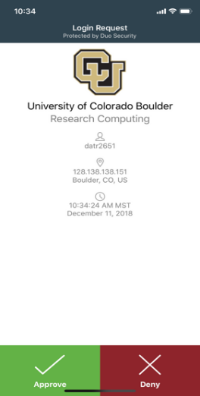
Duo Authentication
Duo smartphone app (recommended)
Phone Call/Text is an alternatives

Slide 35
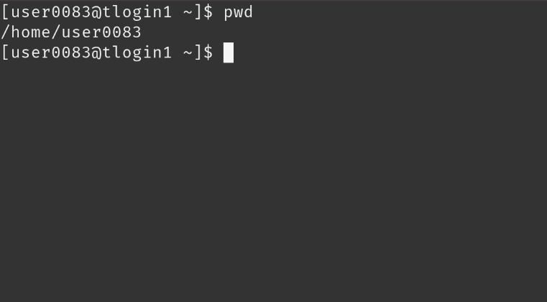
Terminal Access
Mac or Linux
Terminal application
Windows
PuTTY
Powershell
Open OnDemand (alternative for CU affiliates)
For those less familiar with Linux (ondemand.rc.colorado.edu/)

Slide 36
Demo: Logging in via Terminal
To login to an RC login node:
$ ssh <username>@login.rc.colorado.edu
Supply your IdentiKey* password and your Duo app will alert you to confirm the login
* Exclusive to CU and CSU accounts

Slide 37
Demo: logging in with OnDemand
CURC Open OnDemand is a browser based, integrated, single access point for all of your HPC resources at CU Research Computing.
CU Boulder: Visit https://ondemand.rc.colorado.edu.
Other RMACC Institutions: Visit https://ondemand-rmacc.rc.colorado.edu/

Slide 38
Asking for Help

Slide 39
Help! I’m stuck, where do I go?
CURC Documentation: curc.readthedocs.io
External Resources
The Internet! (Stack Overflow, YouTube, etc.)
Trainings & Consults with Center for Research Data and Digital Scholarship (CRDDS)
CURC Helpdesk: rc-help@colorado.edu

Slide 40
When should I use these?
Documentation: curc.readthedocs.io
Useful at any time! Check the documentation first when you run into issues.
External Resources
Useful for learning a new skill or initial troubleshooting.
Trainings with Center for Research Data and Digital Scholarship
Useful for broad, long-term learning
Drop-in consult hours are held Tue (12-1p) and Thu (1-2p) during the Fall and Spring semesters
CURC Helpdesk: rc-help@colorado.edu
Useful for quick, personalized assistance. We can schedule Zoom consults if needed.

Slide 41
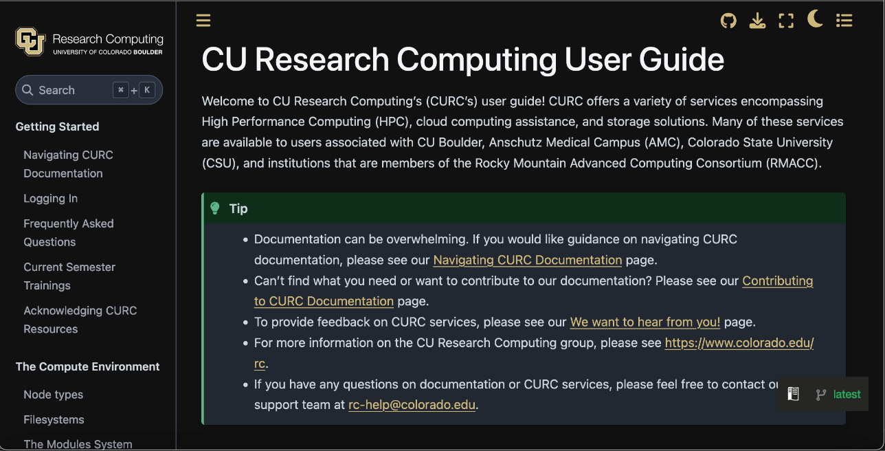
Our Documentation
Located at: https://curc.readthedocs.io

Slide 42
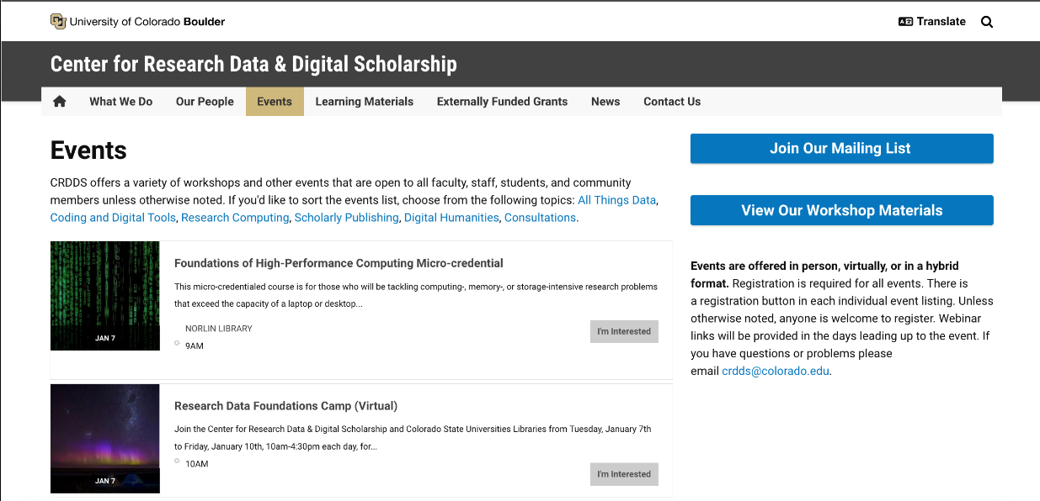
CRDDS trainings and consult hours
View upcoming events at: https://buff.link/crddsevents

Slide 43
Helpdesk Tickets: sub-optimal vs optimal
To: rc-help@colorado.edu
Dear Research Computing,
Help! My code won’t run! Help!
Help please, Andy
To: rc-help@colorado.edu
Dear Research Computing,
I am running into issues running my Python script. I am using a conda environment called my_python_env with the pytorch software, and I am receiving the following error. I am not sure how to troubleshoot. My job ID is 620350. Let me know what I can try!
srun: fatal: SLURM_MEM_PER_CPU, SLURM_MEM_PER_GPU, and SLURM_MEM_PER_NODE are mutually exclusive.
Thanks, Andy

Slide 44
Helpdesk Tickets: sub-optimal vs optimal
To: rc-help@colorado.edu
Dear Research Computing,
Can you install pytorch for me?
Thanks, Andy
To: rc-help@colorado.edu
Dear Research Computing,
I am looking to utilize PyTorch to use in conjunction with AMD GPUs. I have tried an anaconda installation and have so far been unsuccessful. Could you please help me complete this install?
Thanks, Andy

Slide 45
How can I compose an effective ticket?
Provide detail!
Scale down your workflows for testing!
Email our helpdesk!
Try a few things and let us know what you’ve tried!
We are not just being lazy – it helps us contextualize the issue.
We would likely try the same things as you – if you can eliminate potential solutions, it will help us get to a solution more quickly.

Slide 46

Documentation
https://curc.readthedocs.io/en/latest/

